Slide 1


USA Airline Customer Satisfaction Analysis
Presented by:
Avin Deshmukh
Lavnish Talreja
Anjali Chintam
Rohit Menon

Slide 2
Objective:
We have undertaken this survey dataset to analyze customers have become dissatisfied with certain air travel, why certain trips have low satisfaction and identifying attributes impacting customer satisfaction and providing suggestions to help the business grow

Slide 3
Business Questions:
How to improve customer satisfaction rating for airlines?
What are the attributes of an airline that influence customer’s satisfaction rating?
How does the age affect a customer’s decision on their rating?
Does airline Status affect the customer rating?
How does the price affect a customer’s decision on their rating?

Slide 4
Low Satisfaction Airlines:
Our 1st step was to analyze airlines that provided low customer satisfaction
We analyzed it based on the likelihood ,gender and age factor

Slide 5
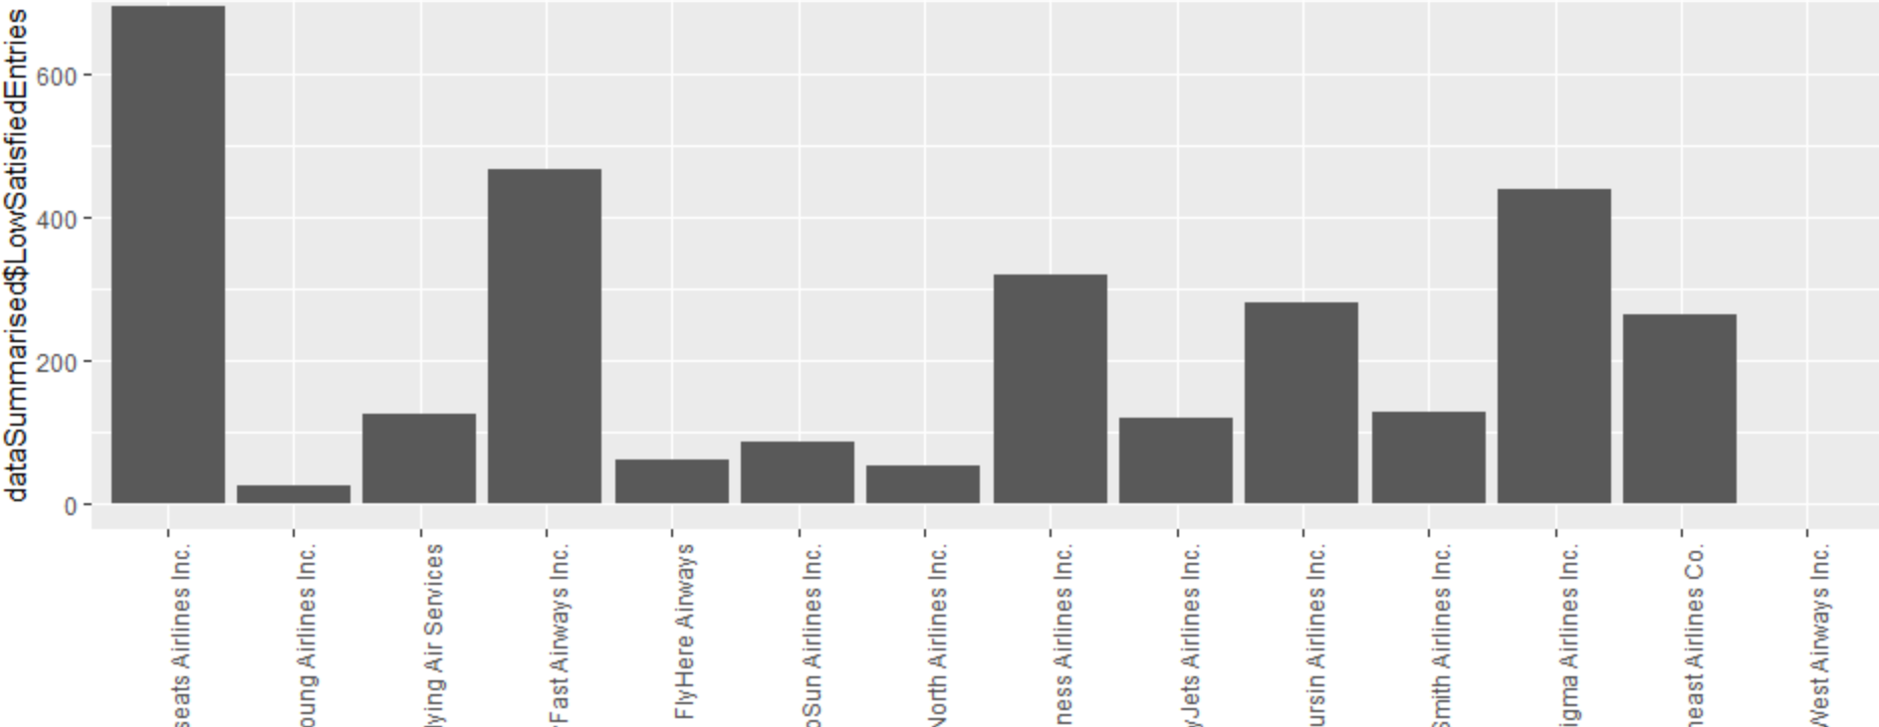
Likelihood to recommend with respect to all airlines for low satisfaction airlines

Slide 6
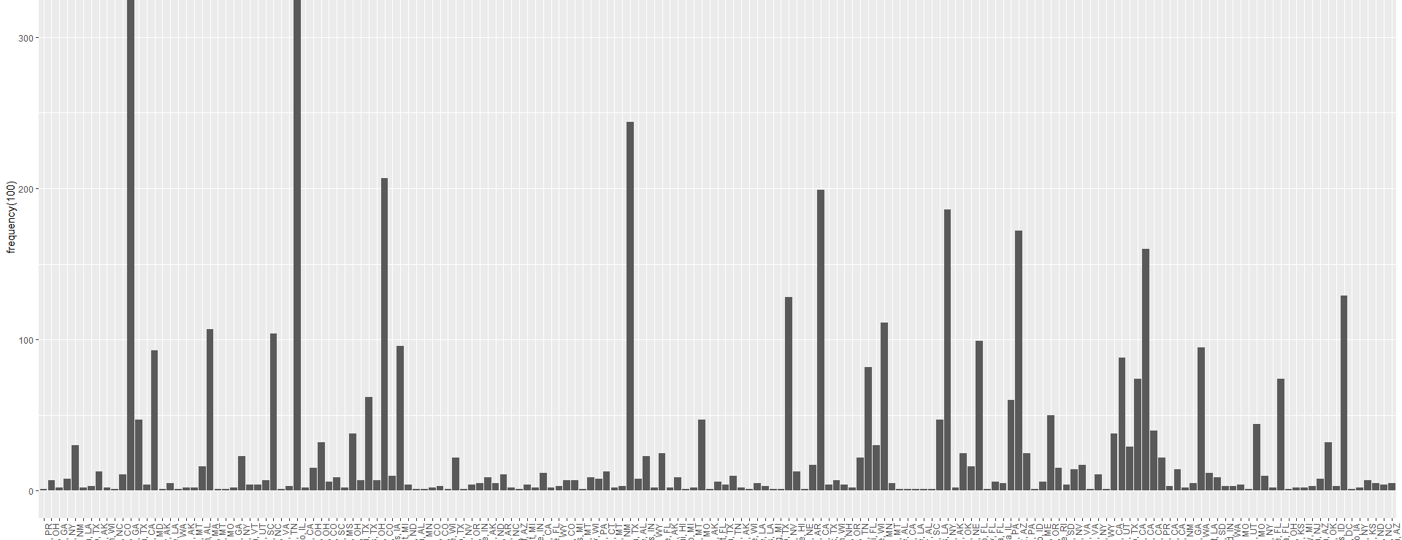
Relationship between Low satisfaction frequency vs destination city

Slide 7
Modelling Techniques:
In order to classify the relevant attributes from the non- relevant ones, we use modeling techniques:
Linear Modelling
Associated Rules Mining
Support Vector machines

Slide 8
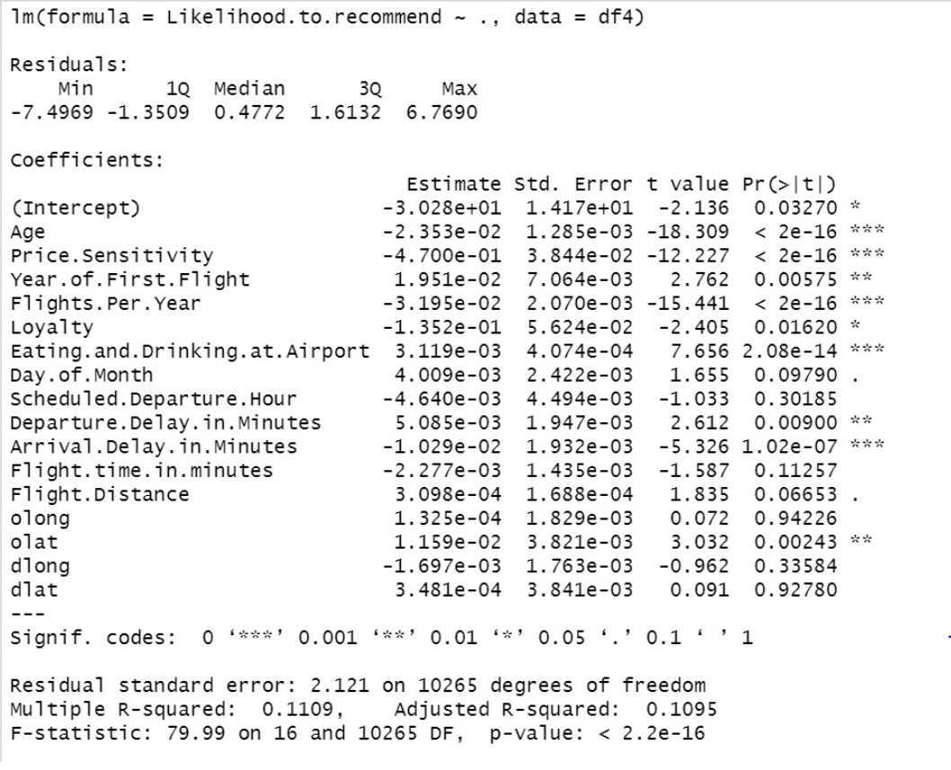
Linear Modelling Output

Slide 9
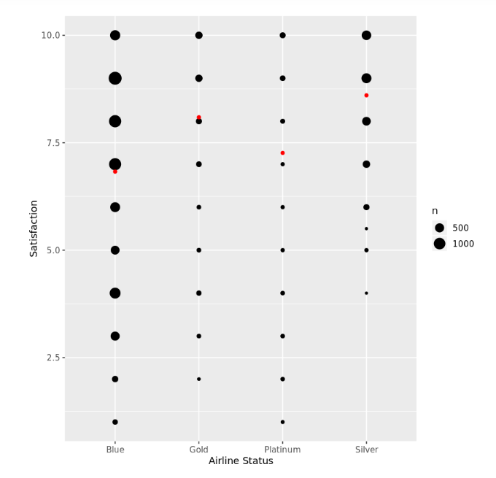
Relationship between Likelihood to recommend and Airline Status

Slide 10
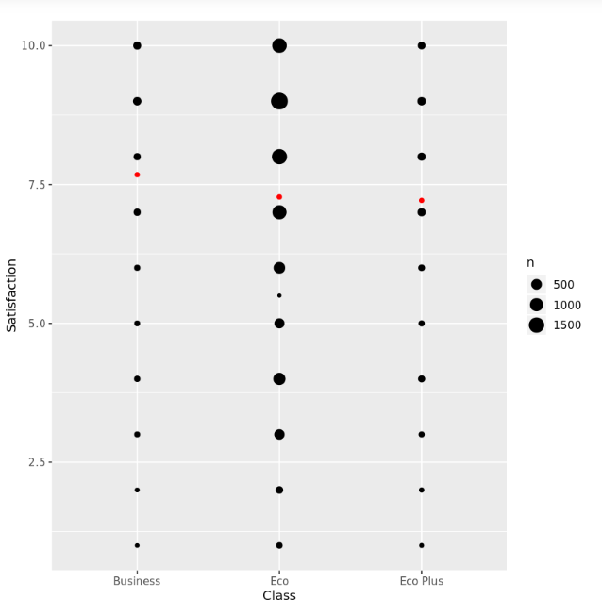
Relationship between Likelihood to recommend and class

Slide 11
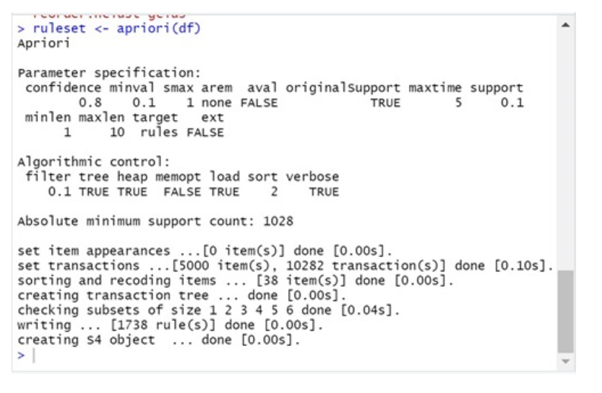
Association rule mining Modeling

Slide 12
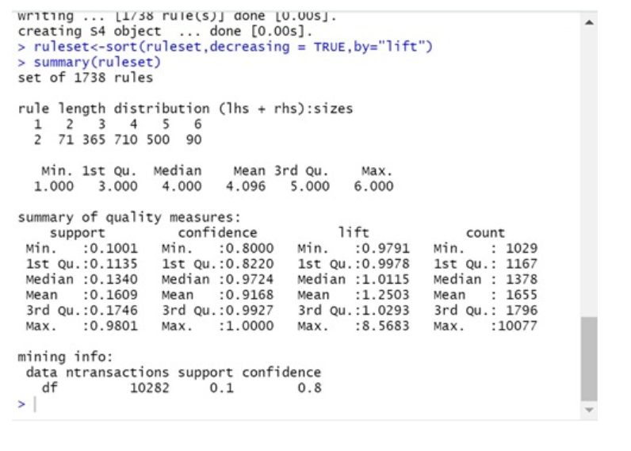
Summary analysis

Slide 13
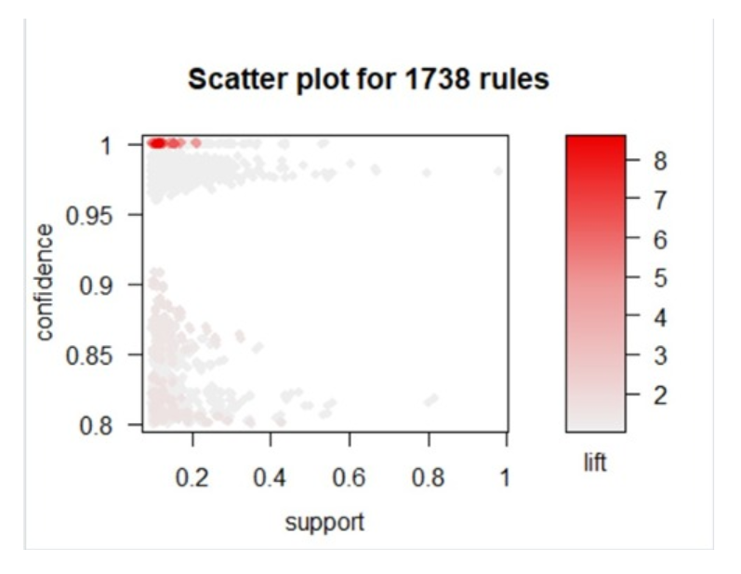
Association rule mining output

Slide 14
Support vector machines
A Support Vector Machine (SVM) is a discriminative classifier formally defined by a separating hyperplane.
In other words, given labeled training data (supervised learning), the algorithm outputs an optimal hyperplane which categorizes new examples.
SVM algorithm is not suitable for large data sets.
SVM does not perform very well, when the data set has more noise i.e. target classes are overlapping.

Slide 15
Actionable insights and recommendations
Offer accomodation to senior citizens if flight gets delayed or cancelled
Customer satisfaction should focus more on people travelling through blue status by providing them with coupons.
Airlines should concentrate more on the economy class passengers

Slide 16
Thank You

